Slide 1

JK Moving Mobile Application
Date: 12/11/2017

Slide 2

Splash Screen

Slide 3
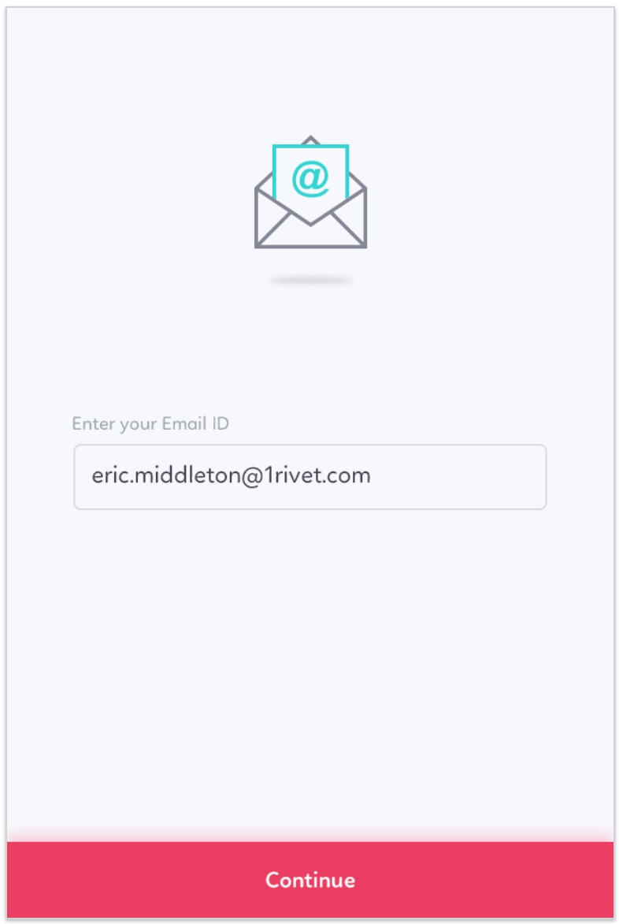
Enter Email

Slide 4
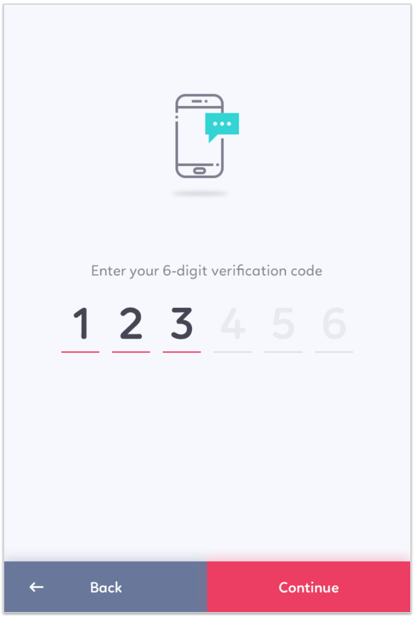
Verification Code Entry

Slide 5
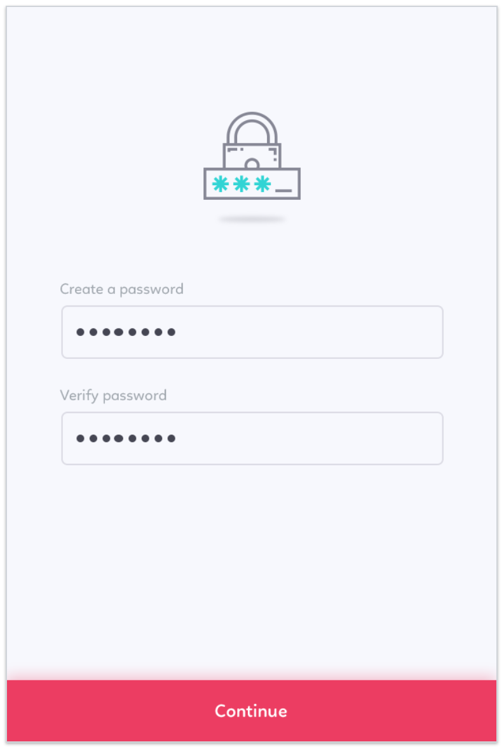
Create Password

Slide 6
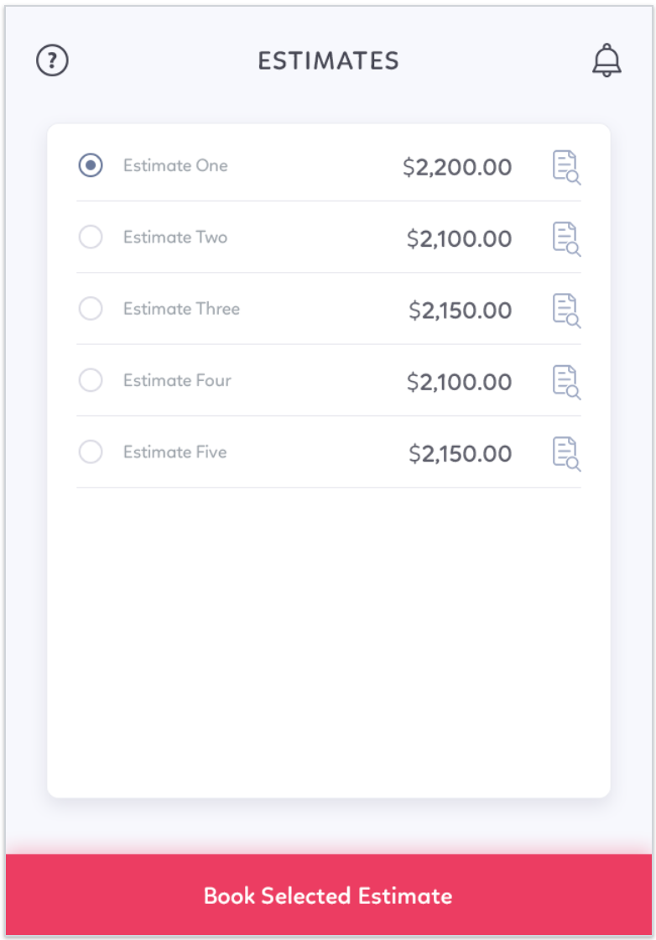
Estimate List – Select Estimate to Book
Notes:
Choose the estimate you want to book
Will enter Description in QM under “Order #” (VARCHAR50- need to map to JIM)

Slide 7
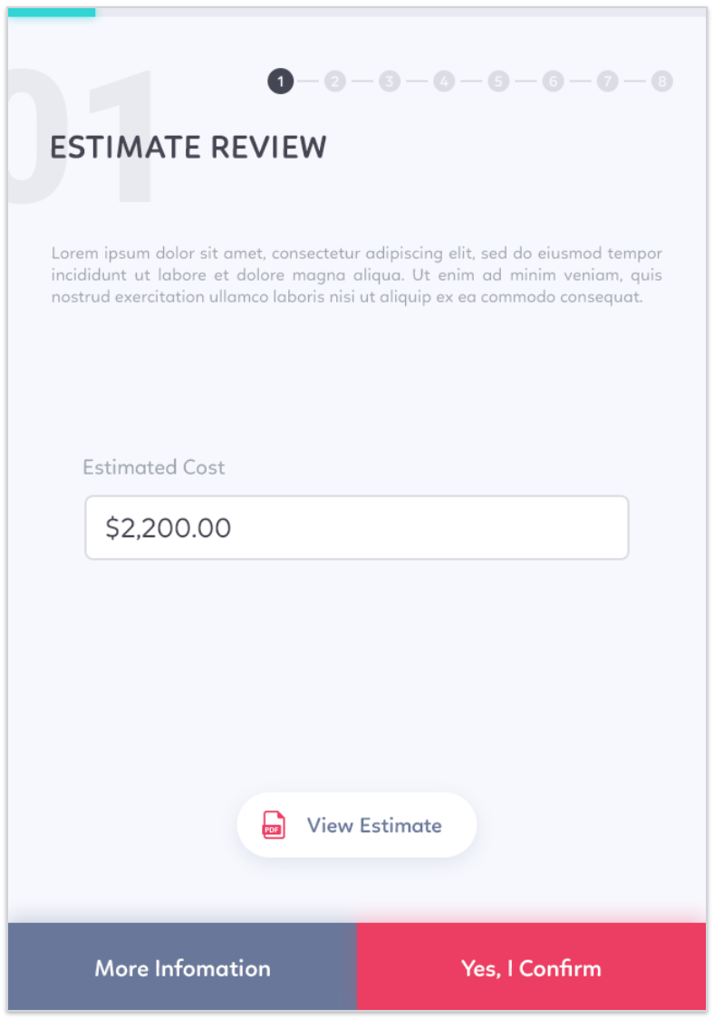
Review Wizard – Estimated Cost
Notes:
View your estimate, or if you’re ready to move ahead click “Yes, I Confirm”.
Change “More Information” to “Get Help”
Assumption: PDF is available and linked to the Customer profile

Slide 8
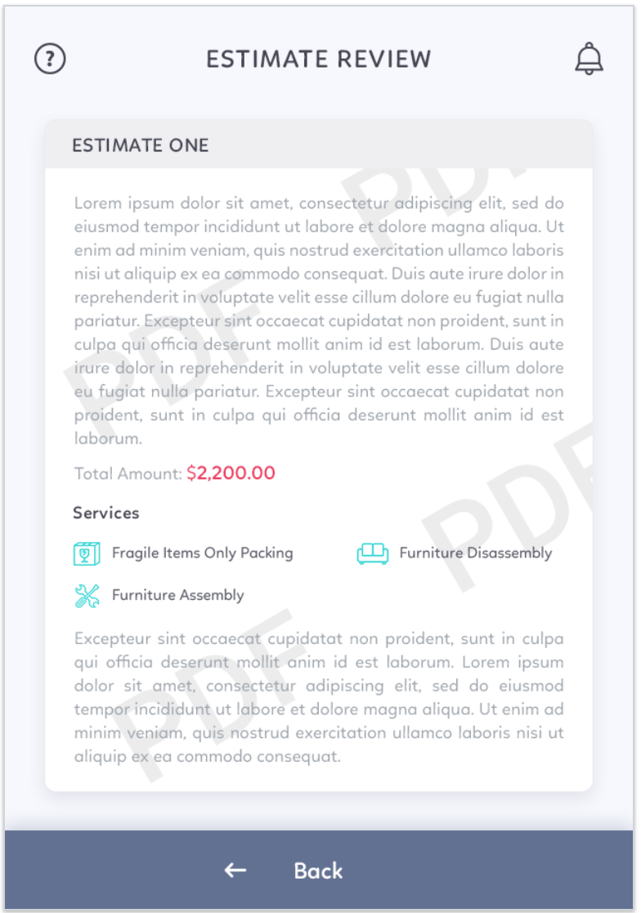
Review Wizard – View Estimate
Notes:
Remove

Slide 9
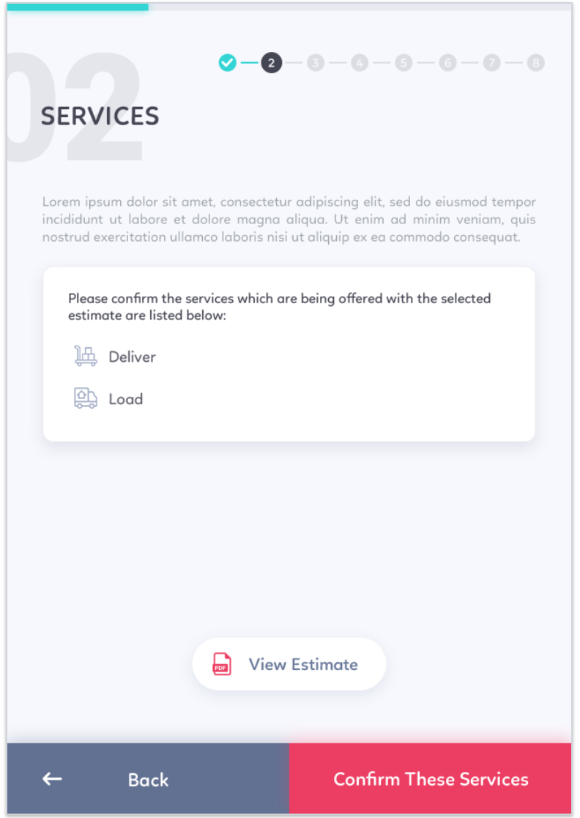
Review Wizard – Service Confirmation

Slide 10
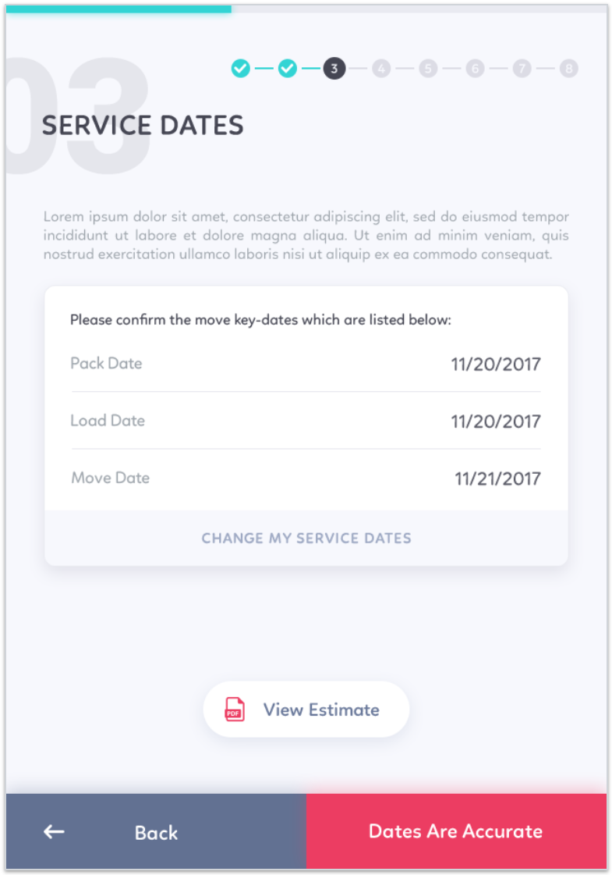
Review Wizard – Service Date Confirmation
Notes:
Change : “Please confirm the service dates listed below”

Slide 11
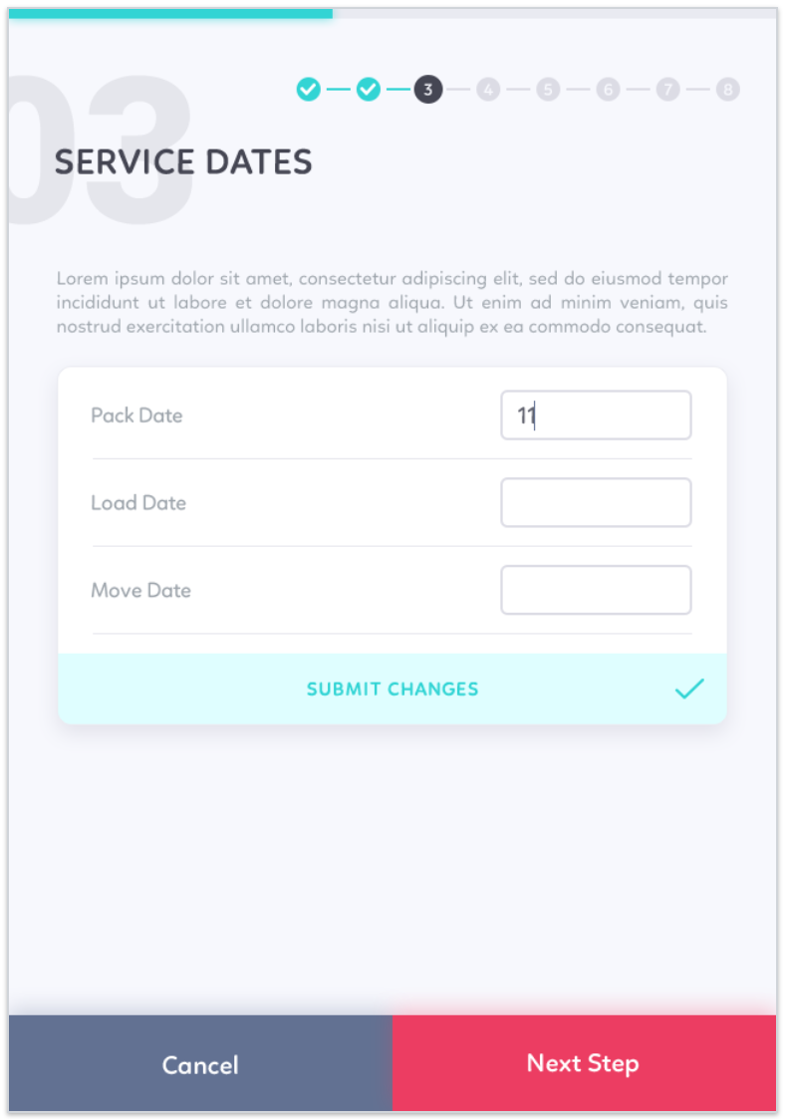
Review Wizard – Service Date Change
Notes:
The scheduled dates don’t work? Please let us know what dates you prefer and we will confirm our availability shortly.

Slide 12
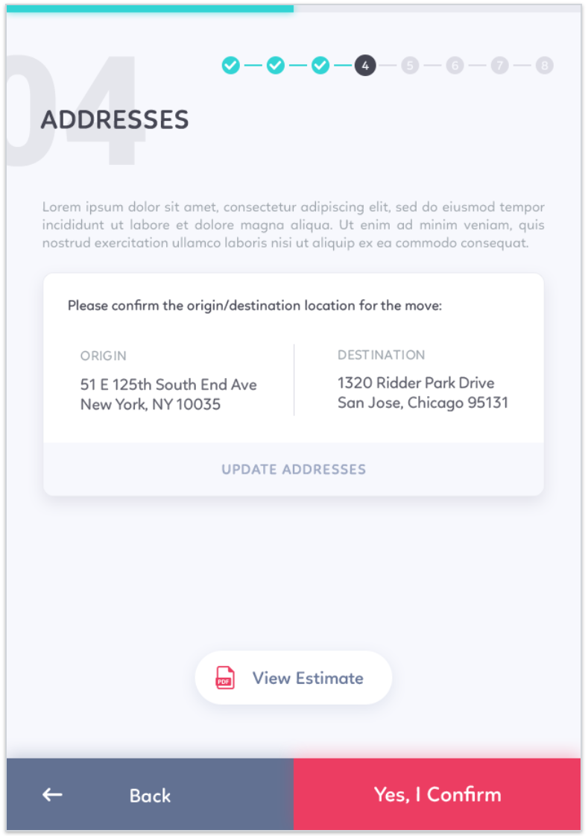
Review Wizard – Addresses Confirmation
Notes:
Please confirm the origin and destination addresses for the move.
If Update Addresses is selected, ‘Please enter the correct address information. We will confirm your changes shortly.'

Slide 13
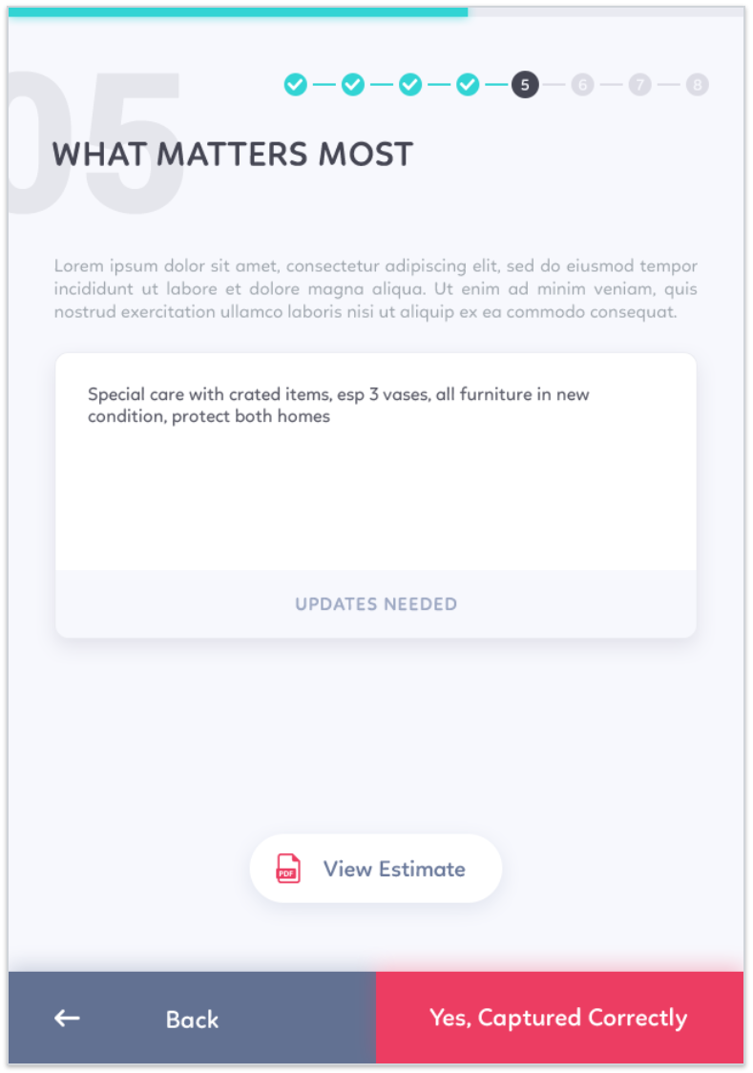
Review Wizard – What Matters Most Confirmation
Notes:
What matters most to you, matters most to us.
If Updates Needed is selected, ‘Please update What Matters Most to you. We will confirm your changes shortly.”

Slide 14
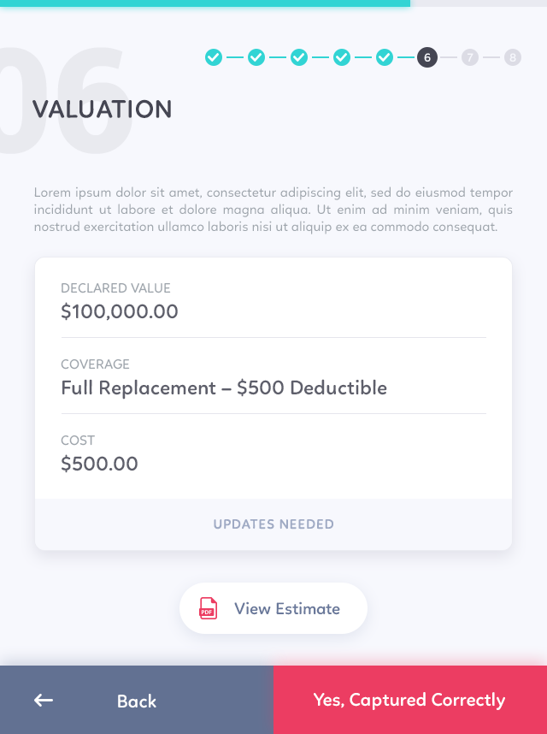
Review Wizard – Valuation Confirmation
Notes:
Do you have the right protection for your goods during services? Please confirm your valuation selection below.
If ‘Updates Needed’ is selected, ‘Please update the Declared Value and selected Coverage. We will confirm your changes shortly.’

Slide 15
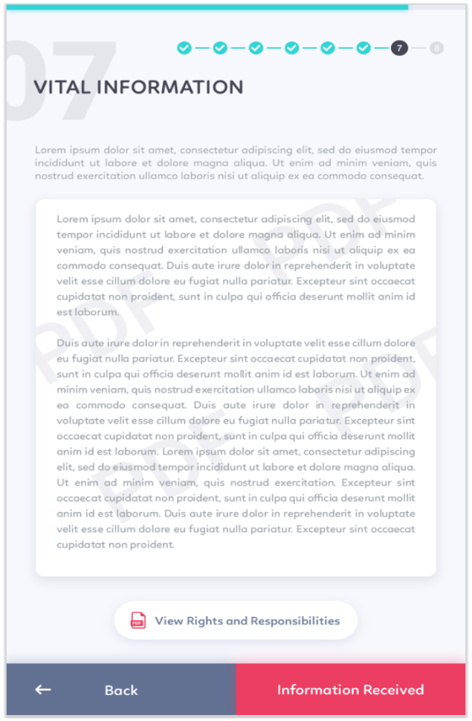
Review Wizard – Vital Information Received
Notes:
Authority Template (confirm w. Patricia)

Slide 16
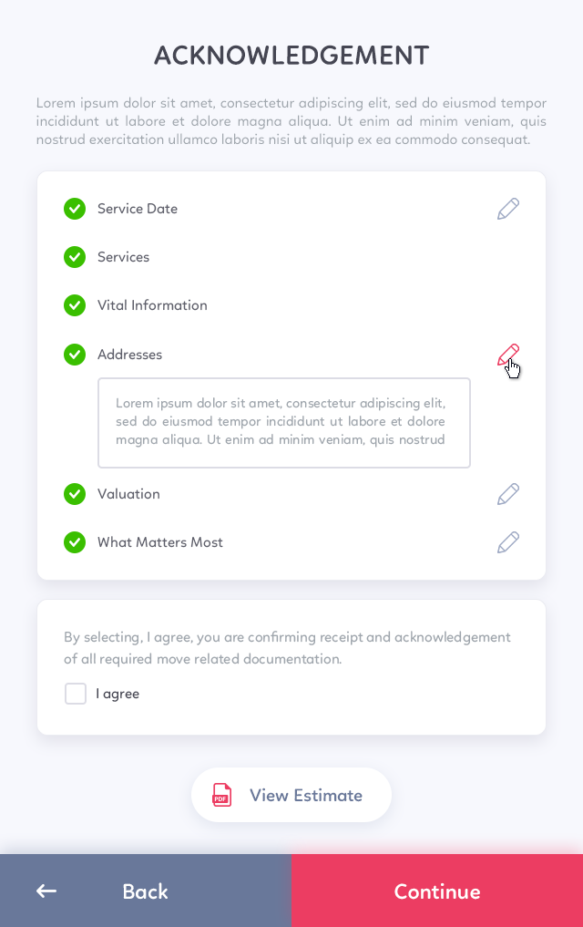
Review Wizard – Acknowledgement Review
Notes:
Please review and confirm all information is accurate.

Slide 17

Review Wizard – Move Confirmed
Notes:
Let’s get Moving!

Slide 18
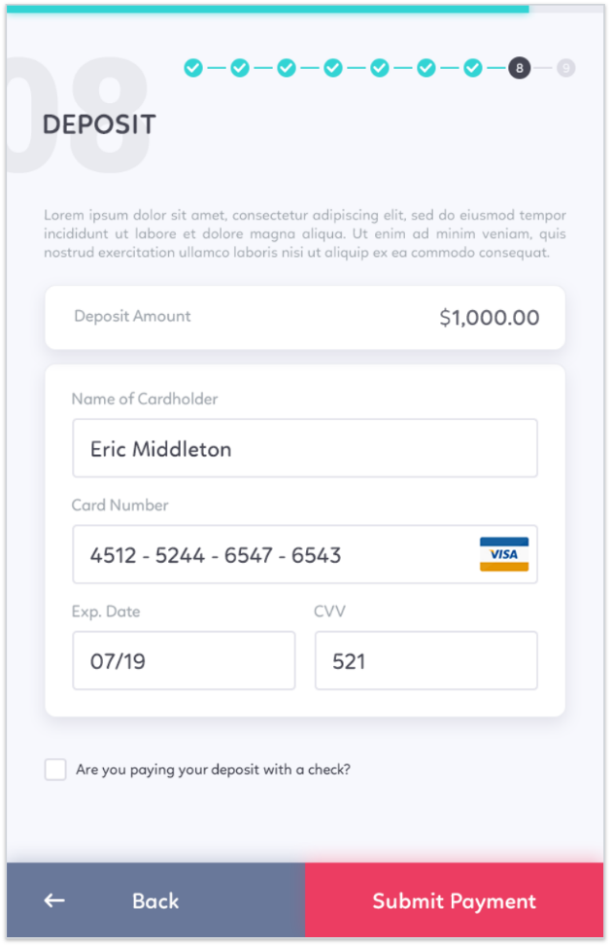
Submit Deposit
Notes:
Please provide your payment details below.

Slide 19
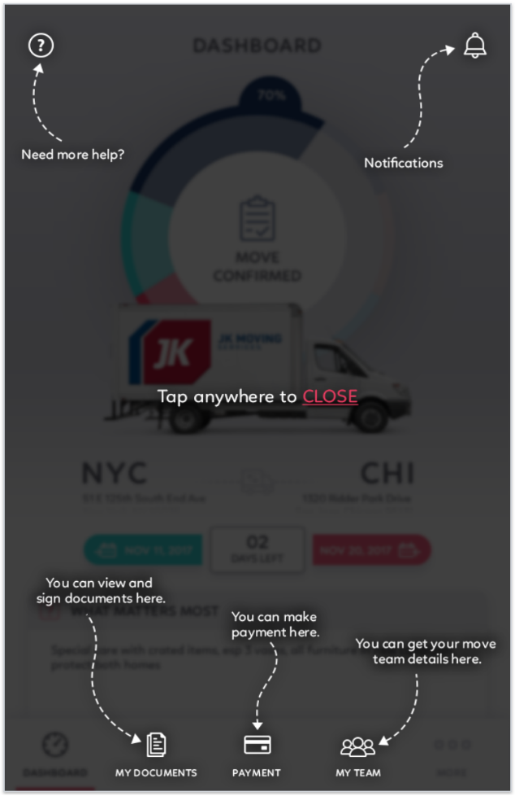
Dashboard Tutorial

Slide 20
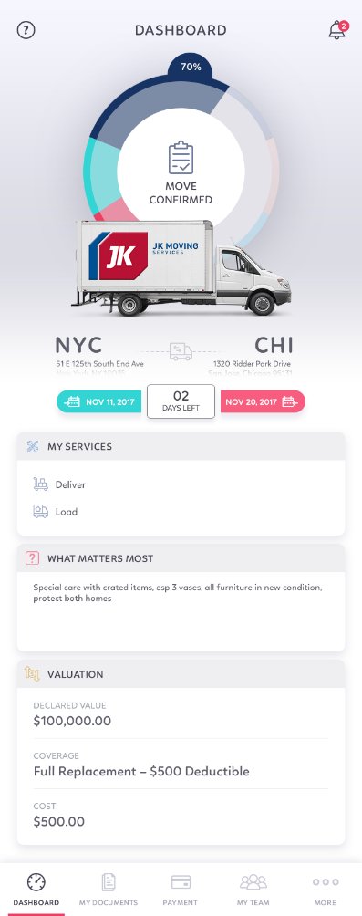
Dashboard – Move Confirmed

Slide 21
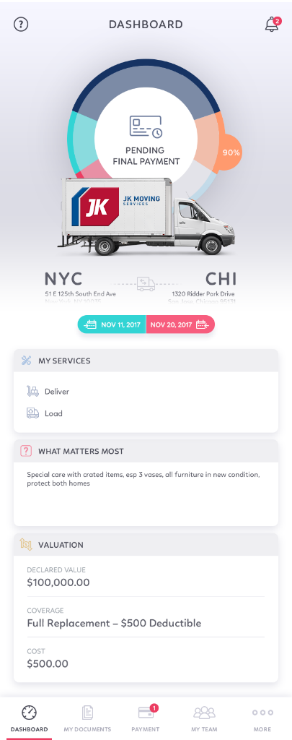
Dashboard – Move Completed

Slide 22
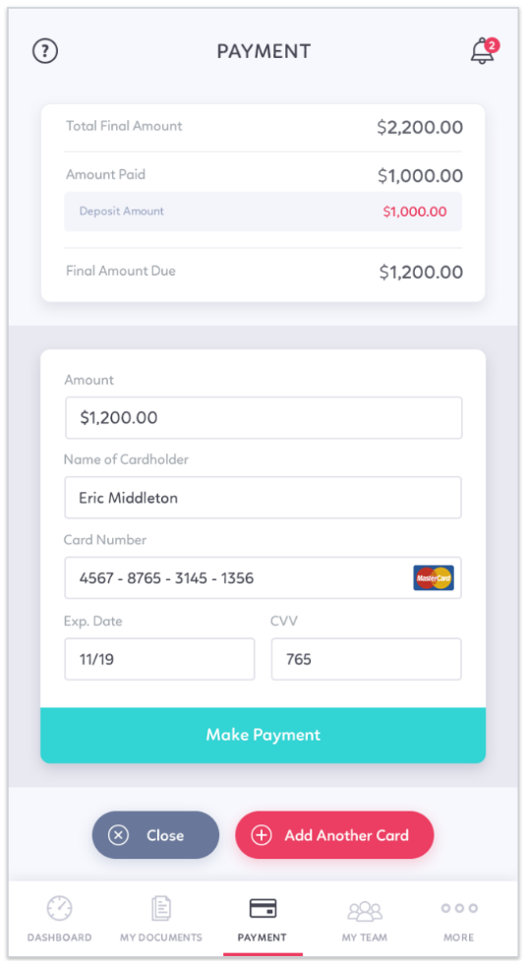
Final Payment - Single

Slide 23
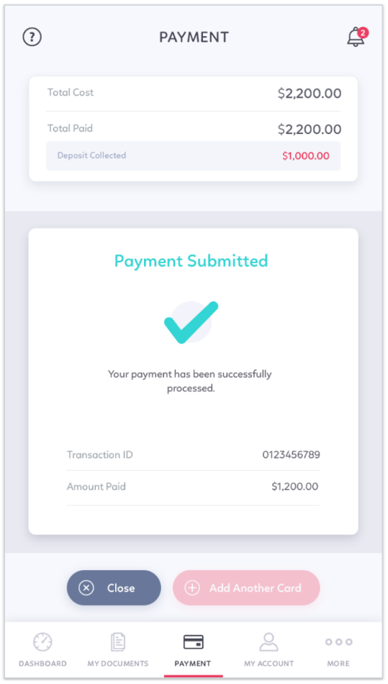
Final Payment Confirmation - Single

Slide 24
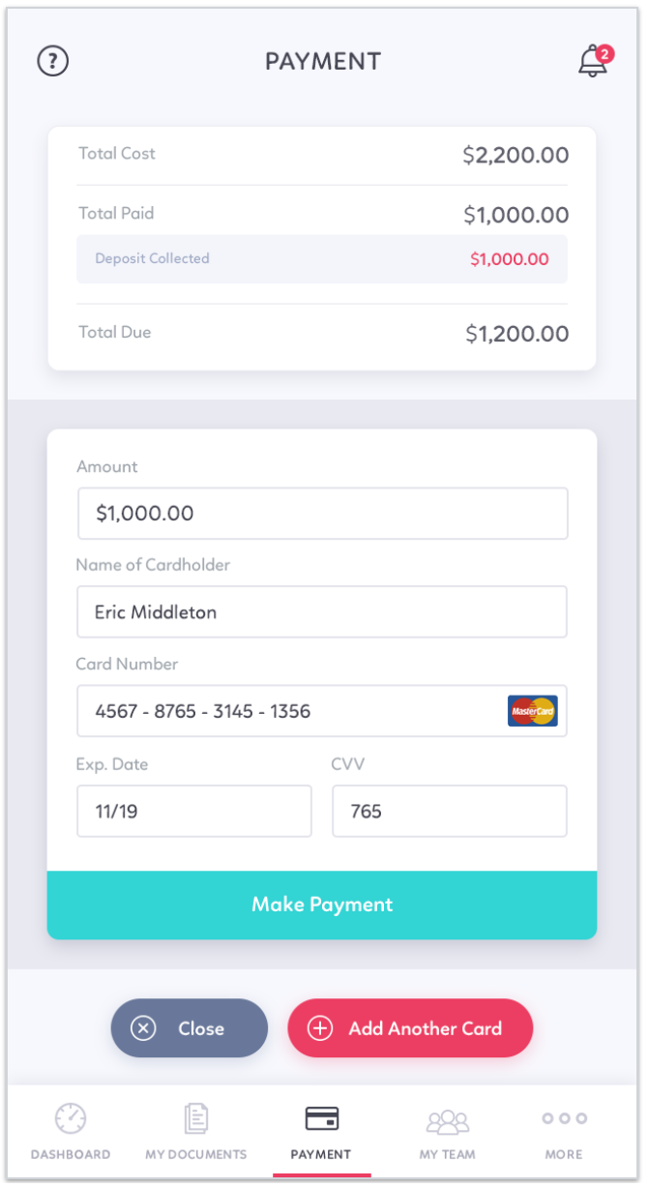
Final Payment - Multiple

Slide 25
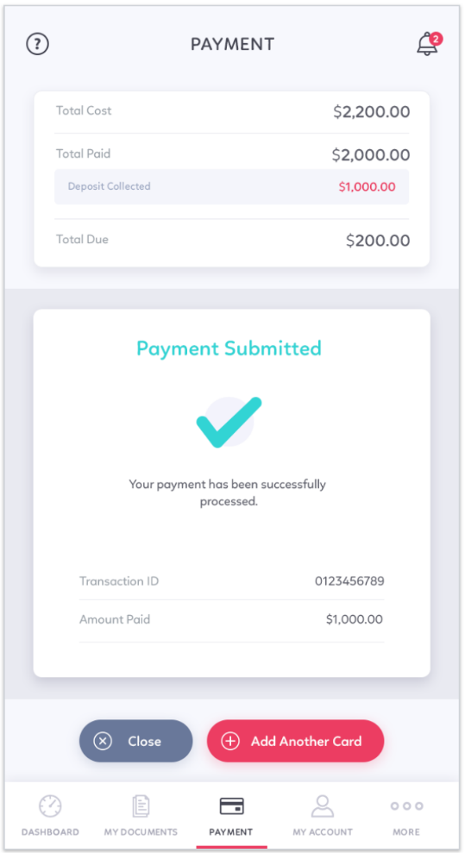
Final Payment Confirmation – First of Multiple

Slide 26
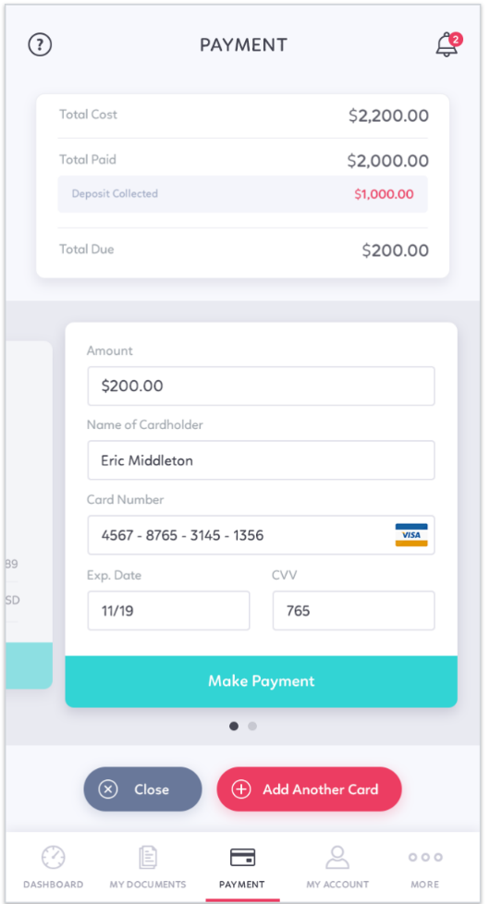
Final Payment – Second of Multiple

Slide 27
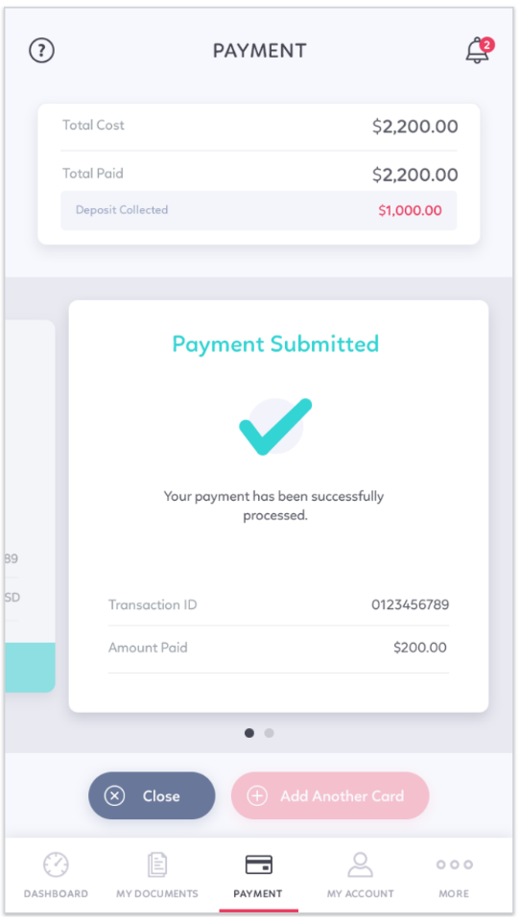
Final Payment Confirmation – Second of Multiple

Slide 28
Appendices
Additional Icons
My Account
Help Screen

Slide 29
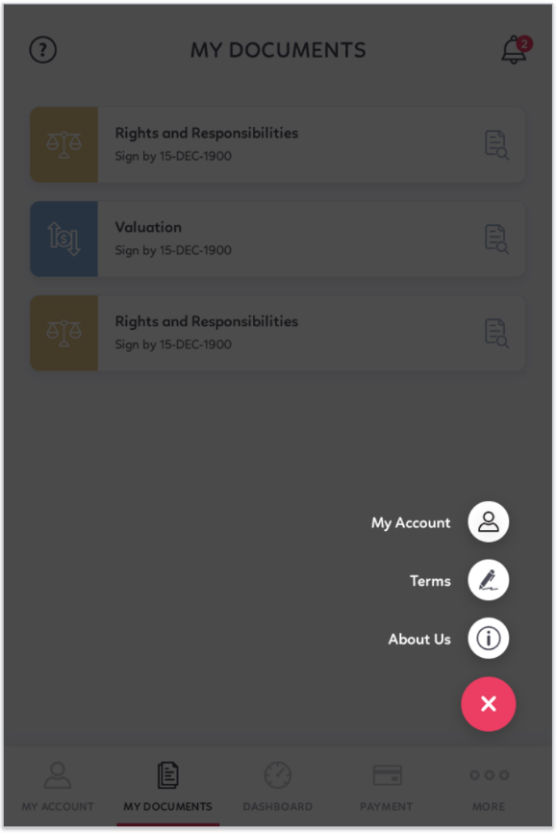
Appendices – Additional Icons

Slide 30
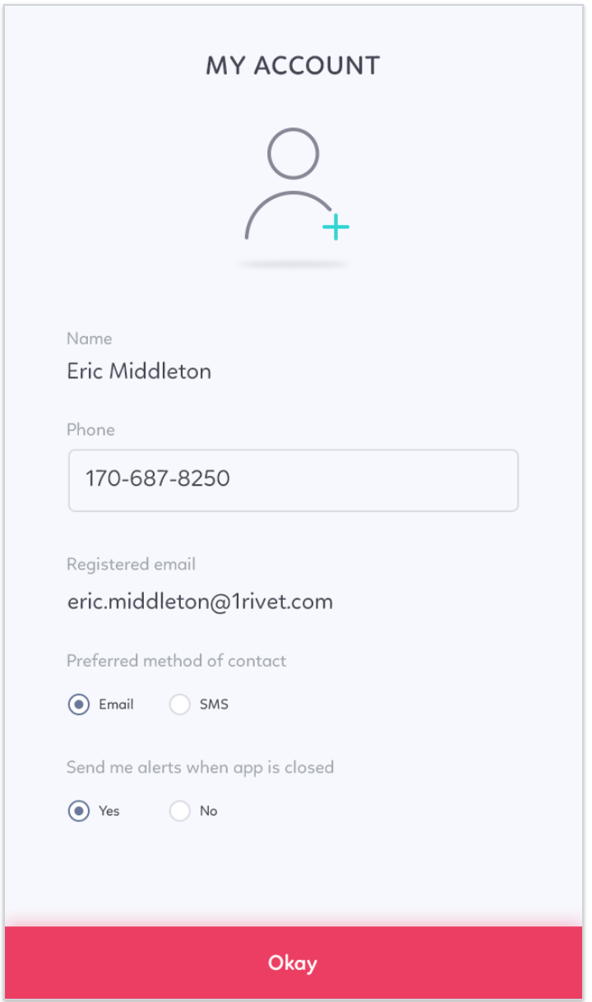
My Account

Slide 31

Appendices – Help Screen
Notes:
How can we help?
Enter your comments or questions below.

